Slide 1




Analysis of Financial Statements
GGUMBA_GroupSubmission_02
[Recording link]
©
©
Venkataramanan Mohandass
Harika Devineni
Muhammed Shahinsha ER
Shaeesta Shaha
Abhay Nagarkoti
Dhiraj Pradhan

Slide 2
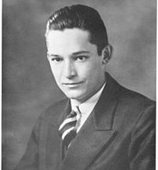
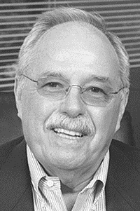
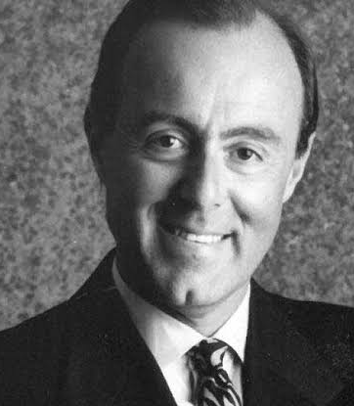




About the Company
GGUMBA_GroupSubmission_02
Mr. Sam Walton
Founder of Walmart
Mr. Jim Sinegal
Founder of Costco
Mr. Jeffrey H. Brotman
Co-founder of Costco
©
©
"To save people money so that
they can live better.“
"To be the destination for customers to save money, no matter how they want to shop."
"To continually provide our members with quality goods and services at the lowest possible prices.“
"A place where efficient buying and operating practices give members access to unmatched savings."

Slide 3




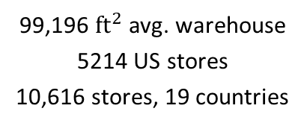
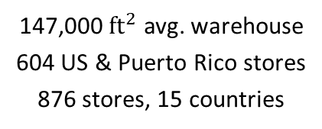
About the Company
Publicly traded US-based Retail companies
GGUMBA_GroupSubmission_02
©
©
Sam Walton
1962, Rogers, AR
$24.53 billion
Earnings, FY2023
Jim Sinegal, and
Jeffrey H. Brotman
1983, Seattle, WA
$9.24 billion
Earnings, FY2023
1.6 million emp. in US
2.1 million emp. worldwide
206,000 emp. in US
316,000 emp. worldwide

Slide 4

Overview of Ratios
GGUMBA_GroupSubmission_02
FY2022 vs. FY2023
Walmart ⇄ Costco
each comp. vs. Industrial Std.
operating efficiently? high quality of earnings? generating enough profits per dollar of revenue, investment, and equity?
at the mercy of other financial institutions for its growth? volatile to interest rates?
Financial
Performances❓
Profitable❓
Leveraged❓
quickly pay off its debts by liquidating its current assets? generate cash quickly?
How . . .
Liquid❓
Efficient❓
managing the flow of its inventories well? turnover the fixed assets into profits?
provide value to its shareholders?
Is the company . . .

Slide 5
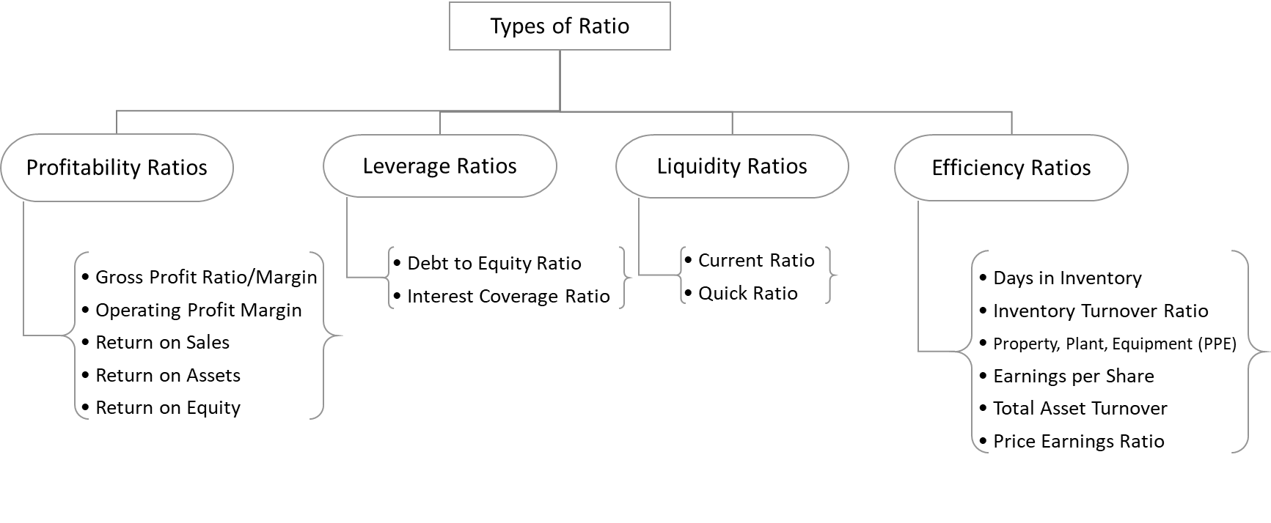
Overview of Ratios
GGUMBA_GroupSubmission_02

Slide 6
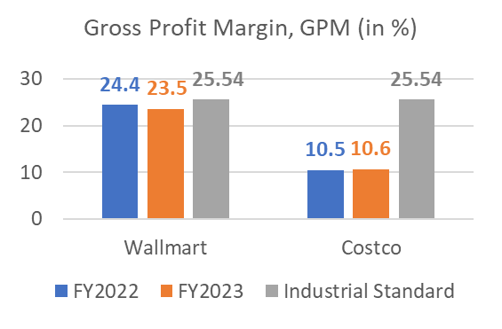
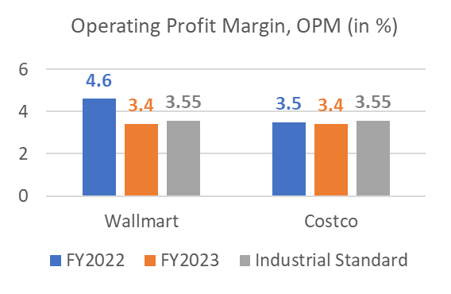
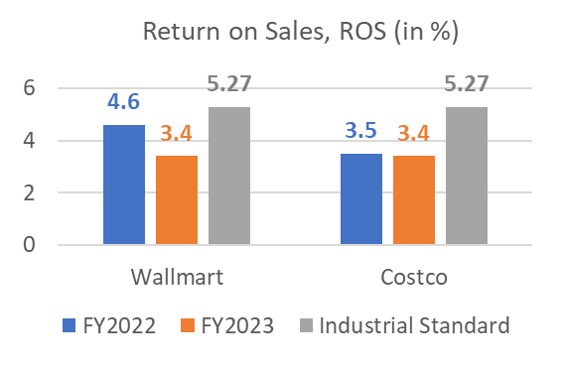
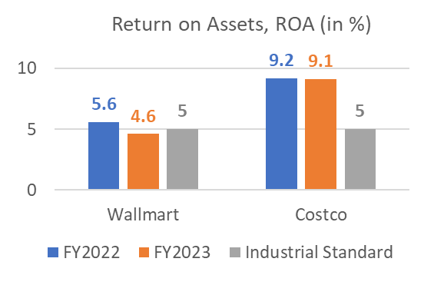
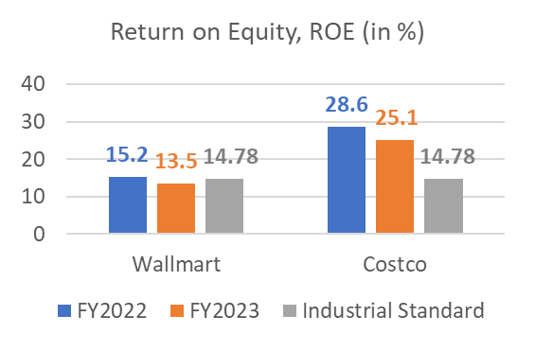
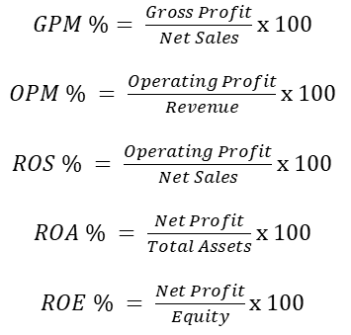
Profitability Ratios
GGUMBA_GroupSubmission_02

Slide 7
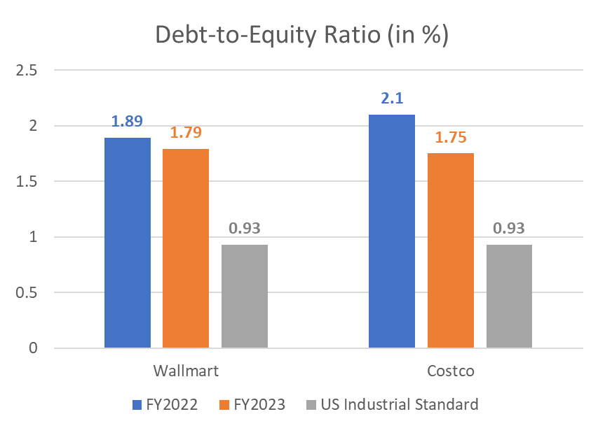
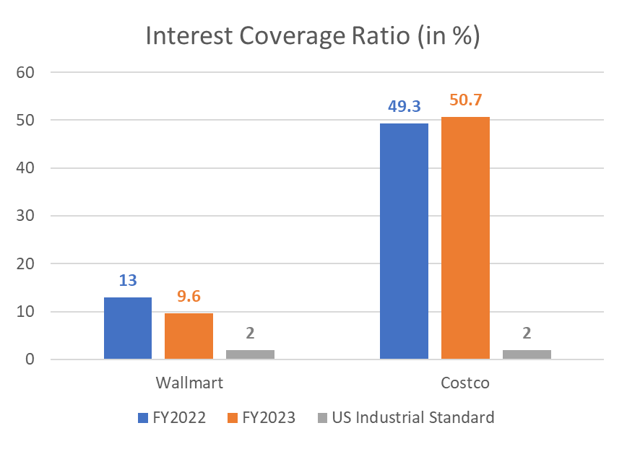


Leverage Ratios
GGUMBA_GroupSubmission_02

Slide 8
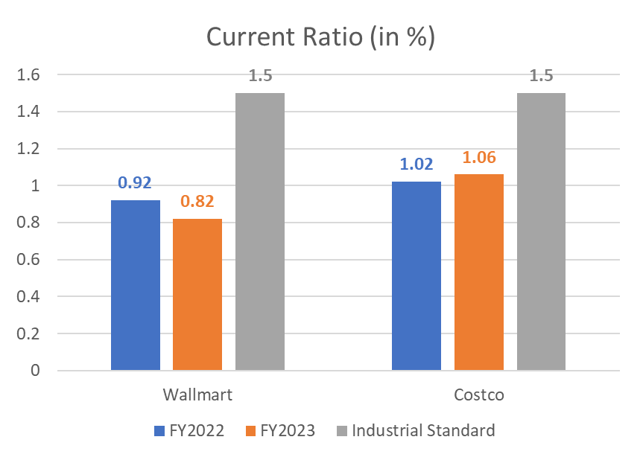
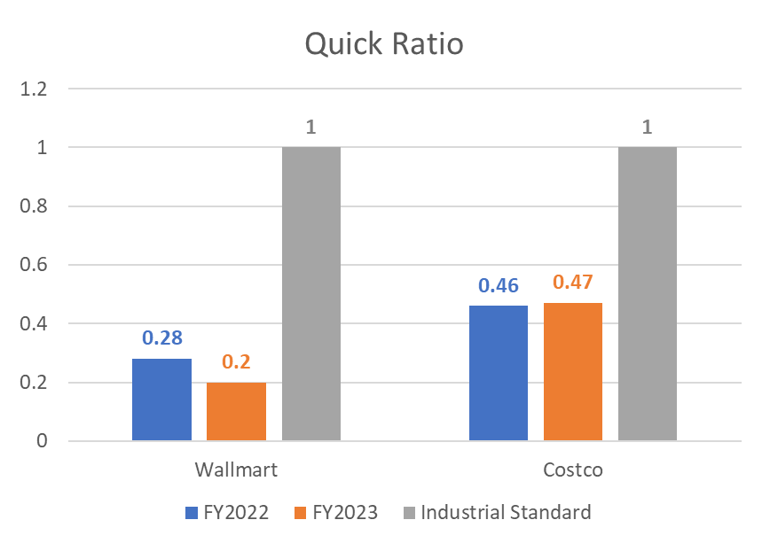
Liquidity Ratios
GGUMBA_GroupSubmission_02

Slide 9
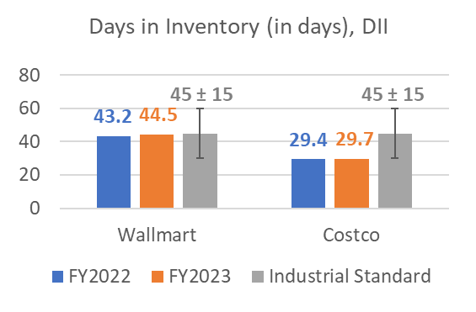
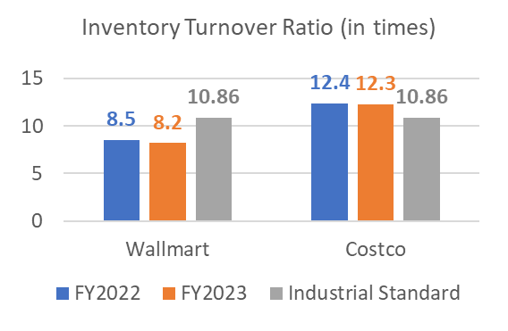
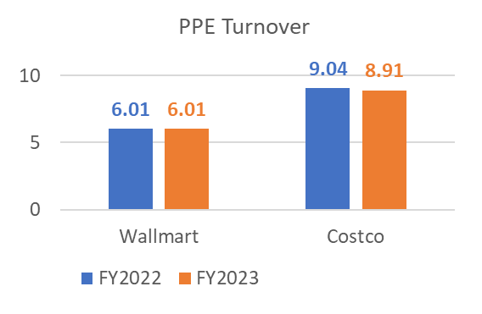



Efficiency Ratios
GGUMBA_GroupSubmission_02
Industrial Standard =
Higher the better

Slide 10
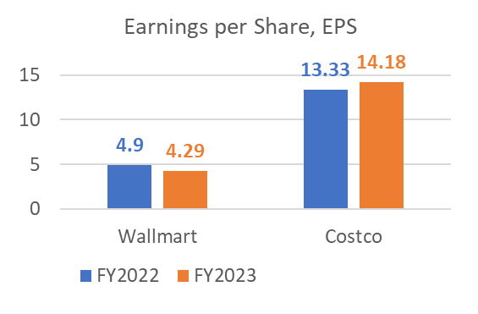
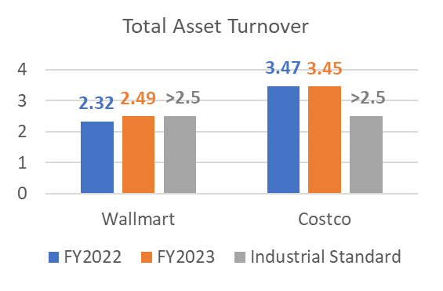
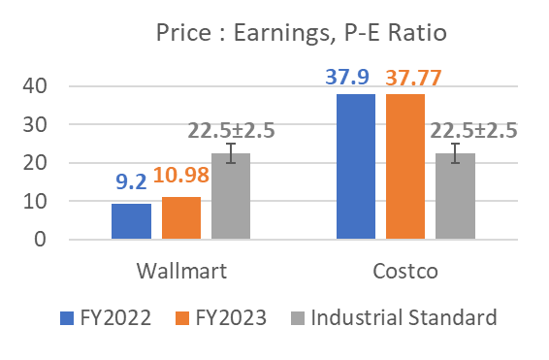



Efficiency Ratios
GGUMBA_GroupSubmission_02
Industrial Standard =
Higher the better

Slide 11
Financial Performance Summary
GGUMBA_GroupSubmission_02
Walmart
Costco
 | FY2022 vs. FY2023 | Walmart vs. Costco | Walmart vs. Industrial Std. | FY2022 vs. FY2023 | Costco vs. Walmart | Costco vs. Industrial Std.
Profitability Ratios
Leverage Ratios
Liquidity Ratios
Efficiency Ratios
Types
of Ratios
Comparisons
GPM
OPM
ROS
ROA
ROE
GPM
OPM
ROS
ROA
ROE
GPM
OPM
ROS
ROA
ROE
GPM ✓
OPM ✓
ROS ✓
ROA ☓
ROE ☓
GPM
OPM
ROS
ROA
ROE
GPM ☓
OPM ☓
ROS ☓
ROA ✓
ROE ✓
Debt-to-Equity
Interest Coverage
Debt-to-Equity ☓
Interest Coverage ✓
Debt-to-Equity ☓
Interest Coverage ✓
Debt-to-Equity
Interest Coverage
Debt-to-Equity
Interest Coverage
Debt-to-Equity
Interest Coverage
Current Ratio
Quick Ratio
Current Ratio
Quick Ratio
Current Ratio ☓
Quick Ratio ☓
Current Ratio
Quick Ratio
Current Ratio
Quick Ratio
Current Ratio ☓
Quick Ratio ☓
DII
TAT`
P-E
PPE
ITR`
EPS
DII
EPS
ITR` PPE TAT` P-E
DII ✓
EPS ☓
PPE ☓
ITR` ☓
TAT` ☓
P-E ✓
DII
EPS
ITR` PPE TAT` P-E
DII
EPS
ITR` PPE TAT` P-E
ITR` ✓
TAT` ✓
P-E ☓
DII ✓
EPS ✓
PPE ✓
*In the previous slides, all financial performance comparisons for all the 4 types of ratios, including each of its constituents, is reported for both FY2022 and FY2023
*In this slide, the same is reported for FY2023 alone; ✓ depicts a good change for the company whereas, ☓ depicts a bad change for the company
`ITR = Inventory Turnover Ratio
`TAT = Total Asset Turnover

Slide 12
Thank You!
GGUMBA_GroupSubmission_02
Source links:
About Walmart
About Costco
Walmart’s Financial Data
Costco’s Financial Data
Top publicly traded American companies by earnings
US Census Bureau

